Slide 1

Metaverse Campus SKKU Flea Market System
TEAM10

Slide 2
Contents
01
Overview
02
Goal & Methods
03
Team & Strategy
04
Plan & Effect

Slide 3
Overview

Slide 4
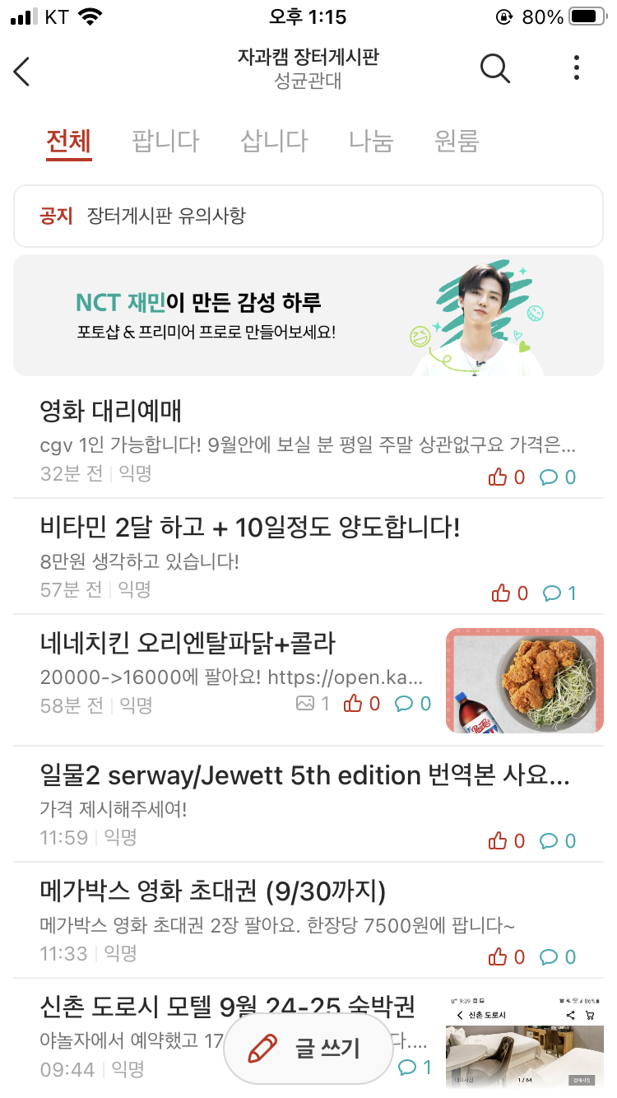
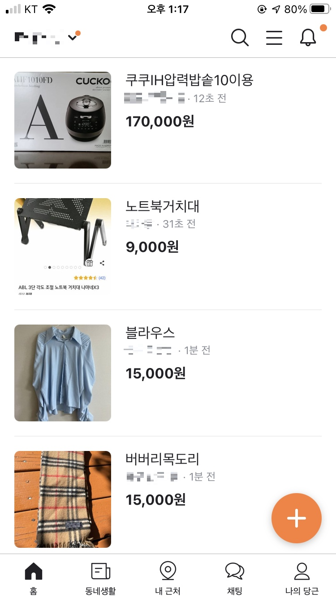
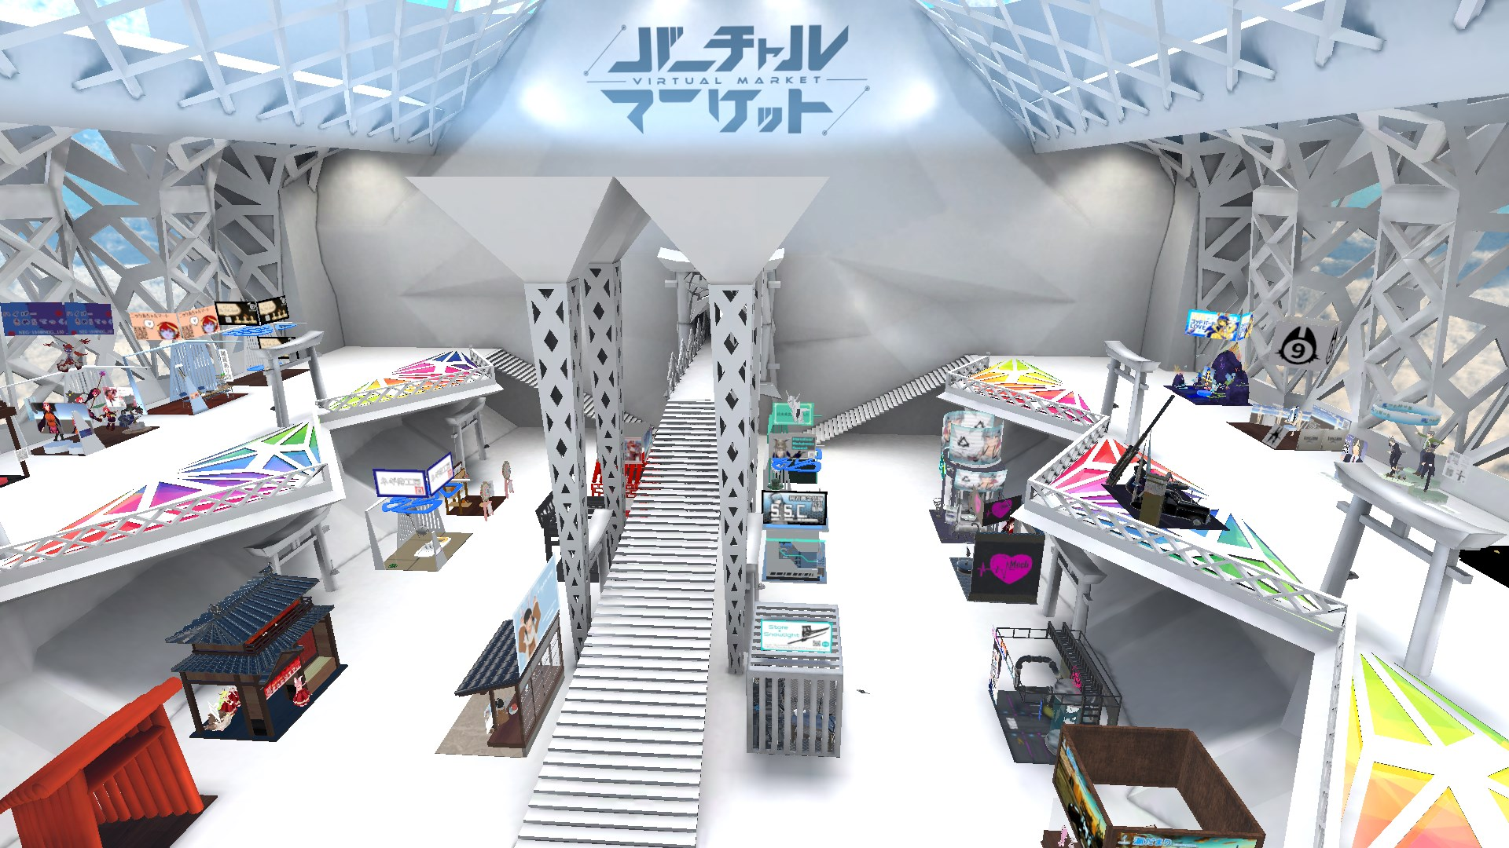
Background
vs
everytime
당근마켓
Metabus Flea Market
There are some flea market service in a form of bulletin board.
We provide real flea market with metabus space and real communication.
to make the users feel like they are at the actual flea market.

Slide 5

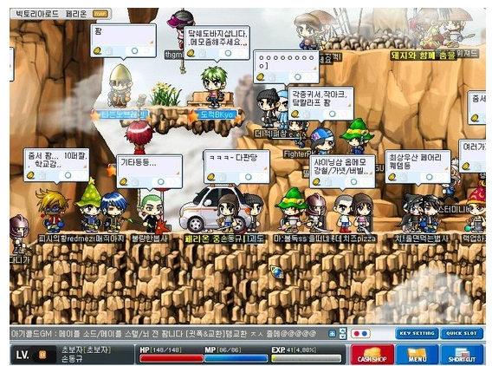

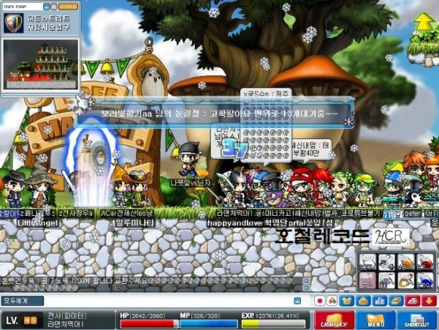
What do we want to make?
01
03
Coronavirus
Flea market system
Corona Virus made us to separate from each other. And that reason leads us to contact online more and more.
For example besides ‘당근마켓’ or ‘everytime’ system, there is online flea market system in Maple story also.
02
We have already experienced these kind of
market system
Beyond the World
People keep trying to contact each other, and do communicative activities via online.
Making a communicative market system that goes beyond the limits of space and time

Slide 6
Goal & Methods

Slide 7
Our Flea Market Services
Trade, buy and sell the items at university!
Promotion System
User Friendly
Promotion System provided by the operator, for seller or the buyer.
Providing users system that they can check items and prices at a glance.
Auction
Integration Ability
Building the bidding system for the flea market, auctions.
Whole system is compatible with other smart campus metaverse.
Security System
Self-Purification
Creating environments where fraud or crime cannot be committed.
Users can review each other for whom use the platform afterwards.

Slide 8
System Stack
System
Graphic
Operation
Avatar
Database
Security
Recommendation
World
Review Integrity
VR Chat
Unity

Slide 9
Methods
System
Promotion
Board
Announce Popular Item
Auction
Show highest price
Show popular Auction
User Friendly
Find Item by keyword
Find Market
Keyword recommendation
Self-Purification
Student ID Verification
Review Recommendation Algorithm
Security
User Permission System
Object Owner System
Review Integrity

Slide 10
Team & Strategy

Slide 11


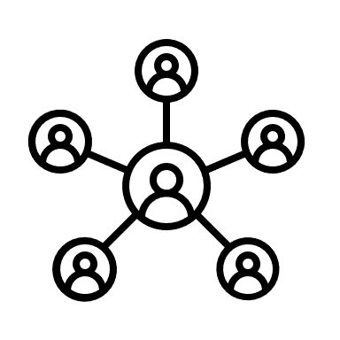

Our Team
Who are we?
3D modeling
Main Functions
Network & Systems
SB, Yoon
JY, Kim
UI/UX Design
HJ, Lim
World design
Static mash
Main functions
Import models
Buy & Selling System
Database
SH, Kim
UI/UX Design
Import models
SH, Choi
JH, Park
Avatar design
Animation
Main functions
Import models
MS, Jang
Chat system
Notice system

Slide 12
Strategy
Development
Conceptual
Design
Procurement
Architectural
Design
System structure development
Define
requirements
Subsystem
engineering
Operation
High-level
system
requirements
System structure development
System
integration
System Testing

Slide 13
Development
Architectural
Design
Identifying components,
such as 3d modeling, networking, 3d model animation
Subsystem
engineering
Use unity or blender with VRchat SDK to develop the components
System
integration
Merge the 3d models, networking systems
System Testing
Upload to the vrchat and test them.

Slide 14



System Testing
Performance
HCI - it is easy ?
Safety, Reliability
Model loading
Use only allowed command
to use the UI/UX
Buy & Sell speed
to find the
functionalities
Accept only
allowed rights
Chat
to understand
Check
The System
scalability

Slide 15
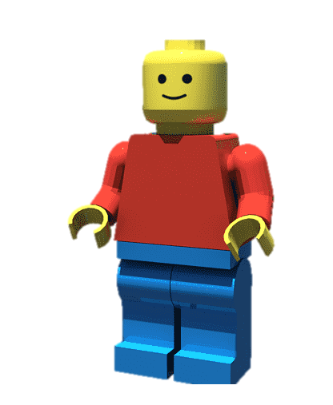
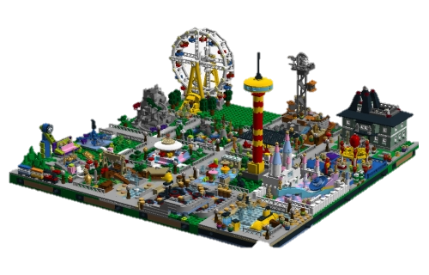

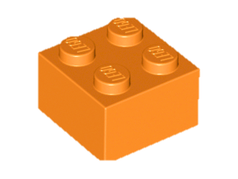
Demonstration process
1
2
3
4
User Acceptance Testing
Integration Testing
Unit testing
System Testing
- Is it possible to move avatars?
- Does the purchase/sales function work well?
- Does the auction function work well?
- Can avatars travel freely in the metaverse world?
- Does purchasing/selling mutually affect each other's results?
- Does auction activity work well together?
- Is there any inconvenience in moving avatars?
- Is there any inconvenience for users to use purchase, sale, or auction functions?
- Can avatars move freely and use functions such as purchase, sale, and auction?

Slide 16
Quantitative evaluation of Goals
Quantitative evaluation of Goals
Evaluation Indicator | Text | Quantitative | Importance
1 | Whether the purchase/sales results apply well to the buyer/seller | 95% ↑ | 20%
2 | User evaluation of avatar & world design | 80% ↑ | 5% ↑
3 | Purchase/Sales/Auction Speed | 5 sec ↓ | 20% ↑
4 | easy for users to use | 95% ↑ | 20% ↑
5 | Accessibility that allows users to use only permitted functions | 90% ↑ | 10% ↑
6 | Expert verification | 90% ↑ | 25% ↑

Slide 17
Plan & Effect

Slide 18
Effect
01
Education
02
Sharing e-books, notes, tools
Sharing learnings, thoughts, talent
Technical
Suggestions of platform of school
flea market system
Metaverse of Smart Campus
03
Social
04
Promoting communication of students
Improving quality of students’ life
Promoting students’ convenience
Economical
Available at affordable price
Eco-friendly : Recycling

Slide 19
Timeline
 | Contents |  | Timeline |  | Content |  | Content |  | Content
 |  |  | ~9/26 | 9/27~ 10/10 | 10/11~ 10/24 | 10/25~11/7 | 11/8~ 11/21 | 11/22~ 12/3 | 12/4~ 12/19 | 12/19~
1 | Requirement Specification
2 | Design | Architecture
3 | Text Here | Define Class
4 | Implement | Component
5 |  | Integration
6 | Code Review
7 | Testing
8 | Prepare Final Presentation
 | Text Here |  | Text Here |  | Text Here |  | Text Here |  | Text Here

Slide 20
Our Services
What is Benefits?
Smart Campus + Metaverse
Students can enjoy campus life without having to come to school in person
Overcome spatial/temporal limitations in COVID-19
Flea Market
Everyone can come and enjoy!
Flea market is familiar with everyone!
Flea market + Metaverse is unique, funny and eye-catching to students
Encouraging active participation of students.
Strong Integration with other projects
Our flea market item can be combined at various events such as
campus festival, school events and library.

Slide 21
Metaverse Campus SKKU Flea Market System
THANK YOU

